Slide 1

DIGITAL ELECTRONICS III Semester CSE, CSE (AIML) & CSE (DS)
Dr. Ajit Kumar Patro
DEPARTMENT OF ELECTRONICS AND COMMUNICATION ENGINEERING
SCHOOL OF ENGINEERING & TECHNOLOGY
GIET UNIVERSITY, GUNUPUR, ODISHA

Slide 2
Reducing Boolean Expressions Boolean Expressions and Logic Diagrams

Slide 3
Example: Simplify the following Boolean functions to a minimum number of literals.
x(x’ + y)
x + x’y
(x + y)(x + y’)
xy + x’z + yz

Slide 4
Solution
x(x’ + y)
= xx’ + xy
= 0 + xy
= xy
x + x’y
= (x + x’)(x + y)
= 1(x + y)
= x + y

Slide 5
Solution
(x + y)(x + y')
= xx + xy’ + xy + yy’
= x + xy + xy’ + 0
= x(1 + y + y’)
= x
xy + x’z + yz
= xy + x’z + yz(x + x’)
= xy + x’z + xyz + x’yz
= xy(1 + z) + x’z(1 + y)
= xy + x’z

Slide 6
Example: Prove that (x + y)(x’ + z)(y + z) = (x + y)(x’ + z)
Solution
(x + y)(x’ + z)(y + z) = (x + y)(x’ + z)
L.H.S. = (x + y)(x’ + z)(y + z)
= (xx’ + xz + x’y + yz)(y + z)
= (xz + x’y + yz)(y + z)
= xyz + xzz + x’yy + x’yz + yyz + yzz
= xyz + xz + x’y + x’yz + yz + yz
= (x + x’)yz + xz + x’y + yz
= yz + xz + x’y + yz = xz + x’y + yz
R.H.S. = (x + y)(x’ + z)
= xx’ + xz + x’y + yz = xz + x’y + yz
L.H.S. = R.H.S. (Proved)

Slide 7
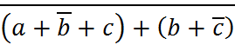
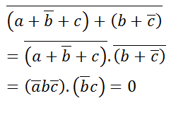
Example: Reduce the expression
Solution

Slide 8
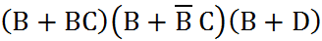
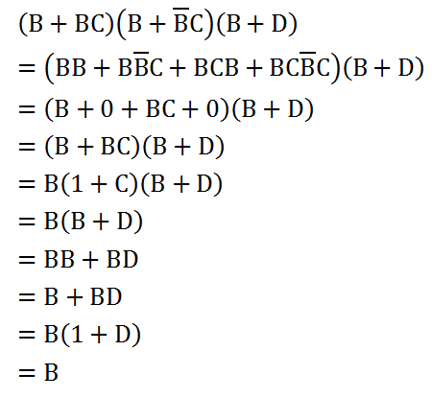
Example: Reduce the expression
Solution

Slide 9
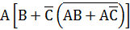
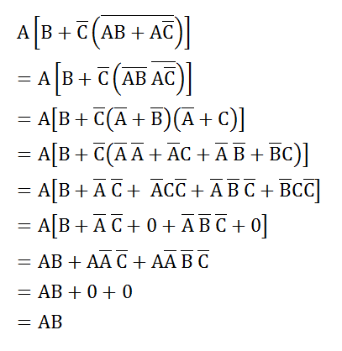
Example: Reduce the expression
Solution

Slide 10
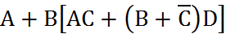
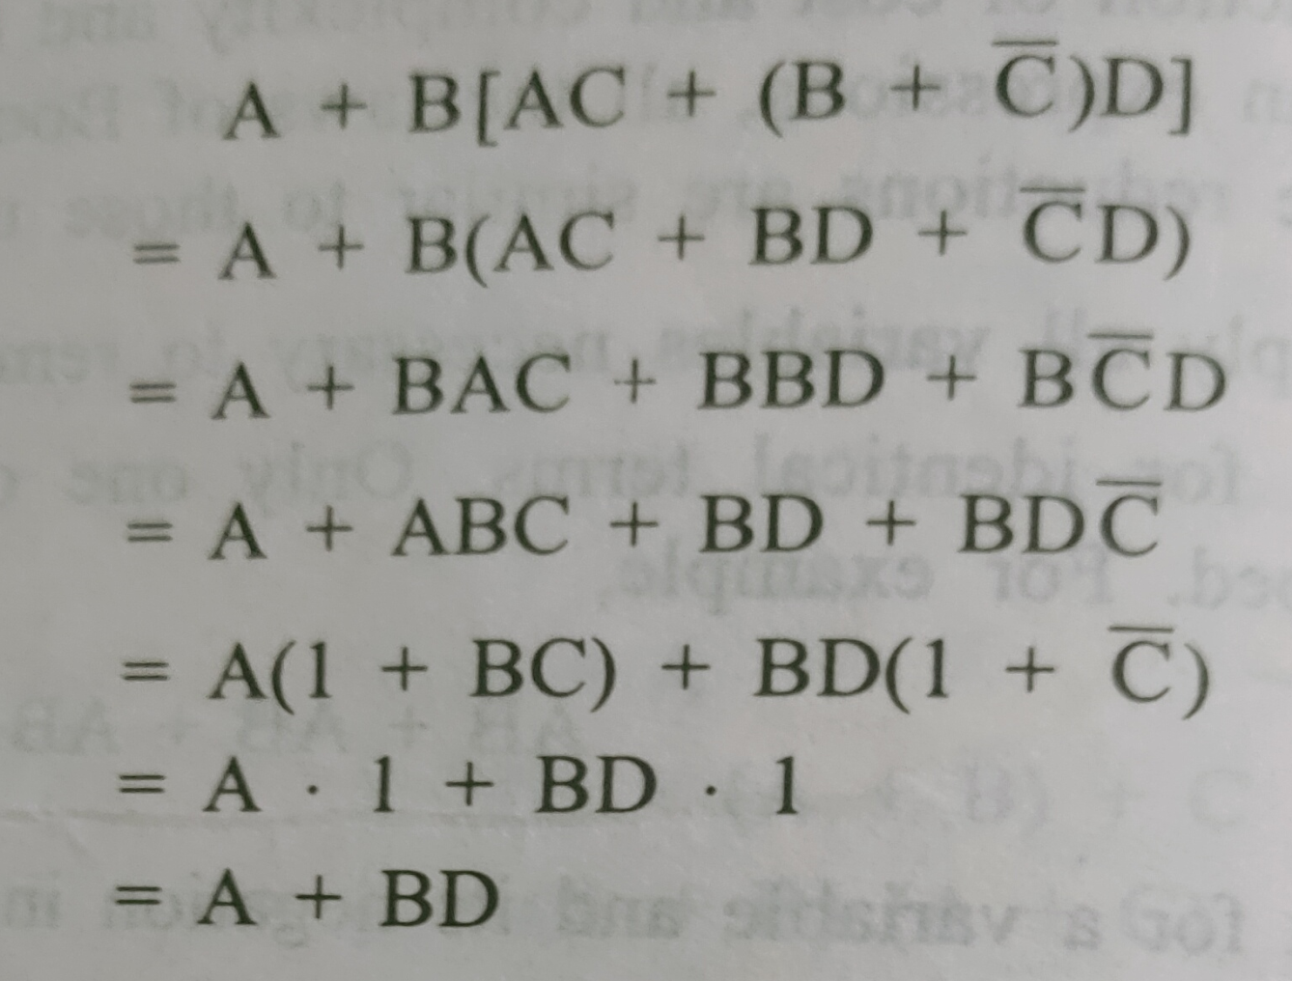
Example: Reduce the expression
Solution

Slide 11
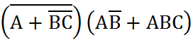
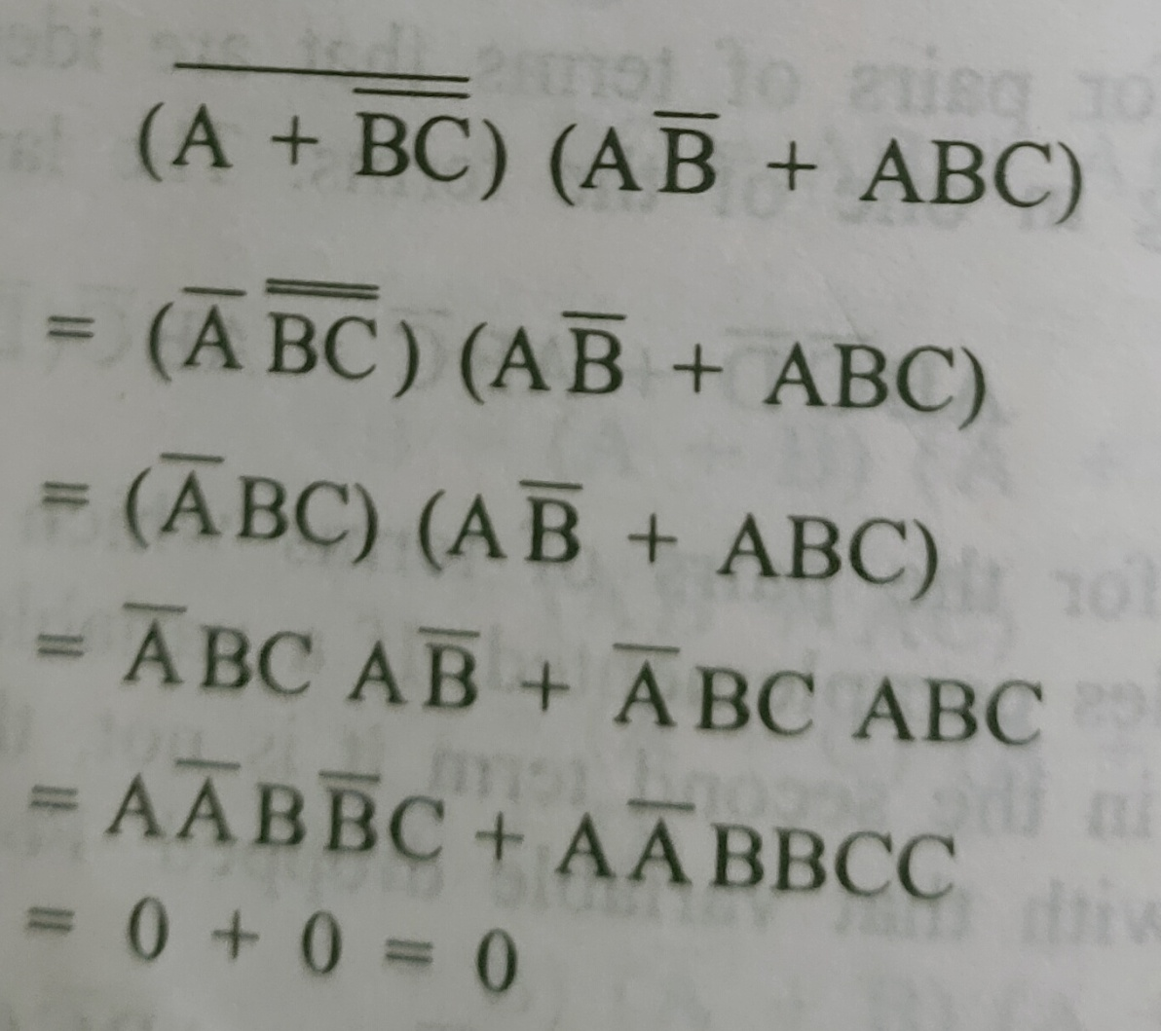
Example: Reduce the expression
Solution

Slide 12
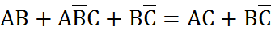
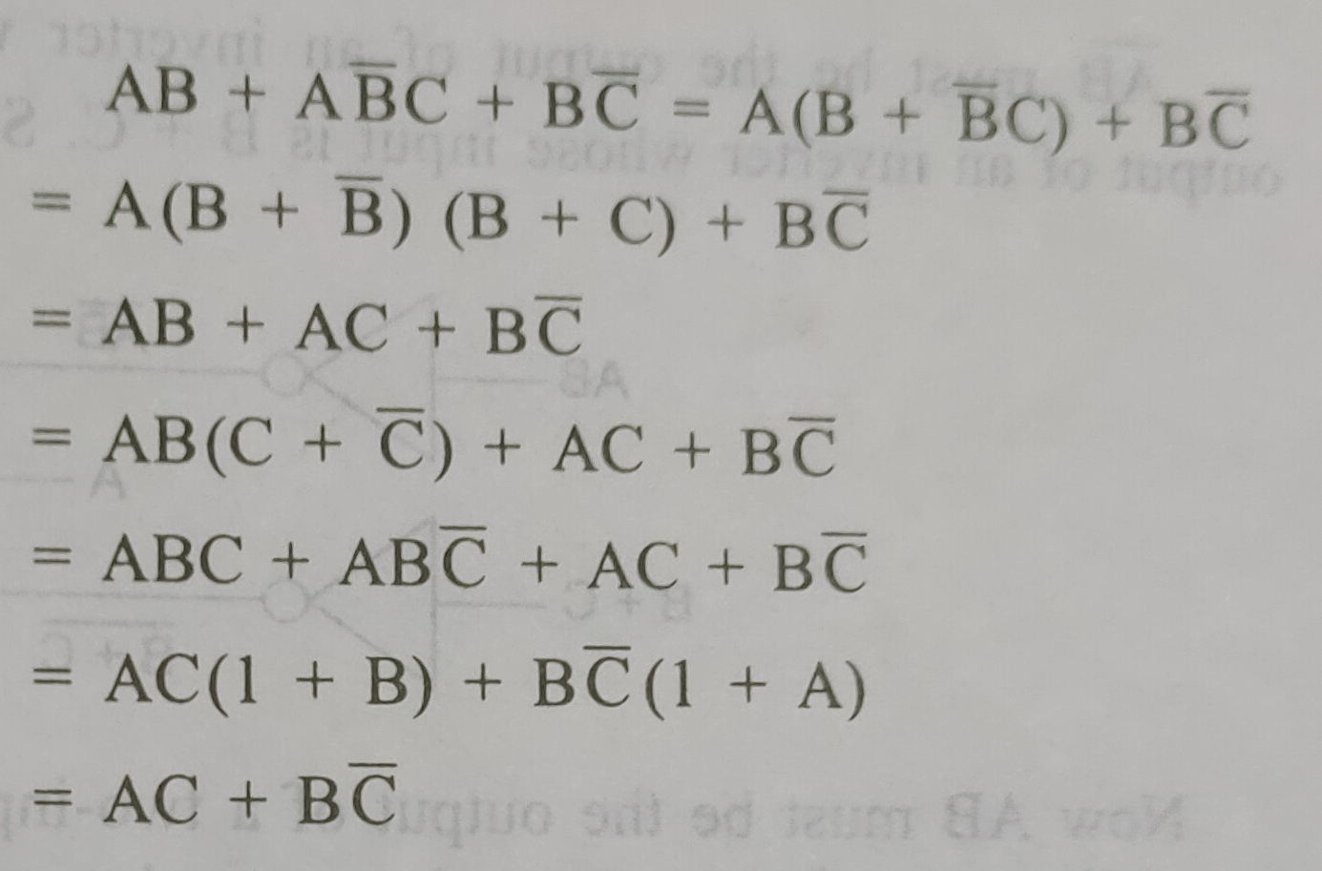
Example: Show that
Solution

Slide 13
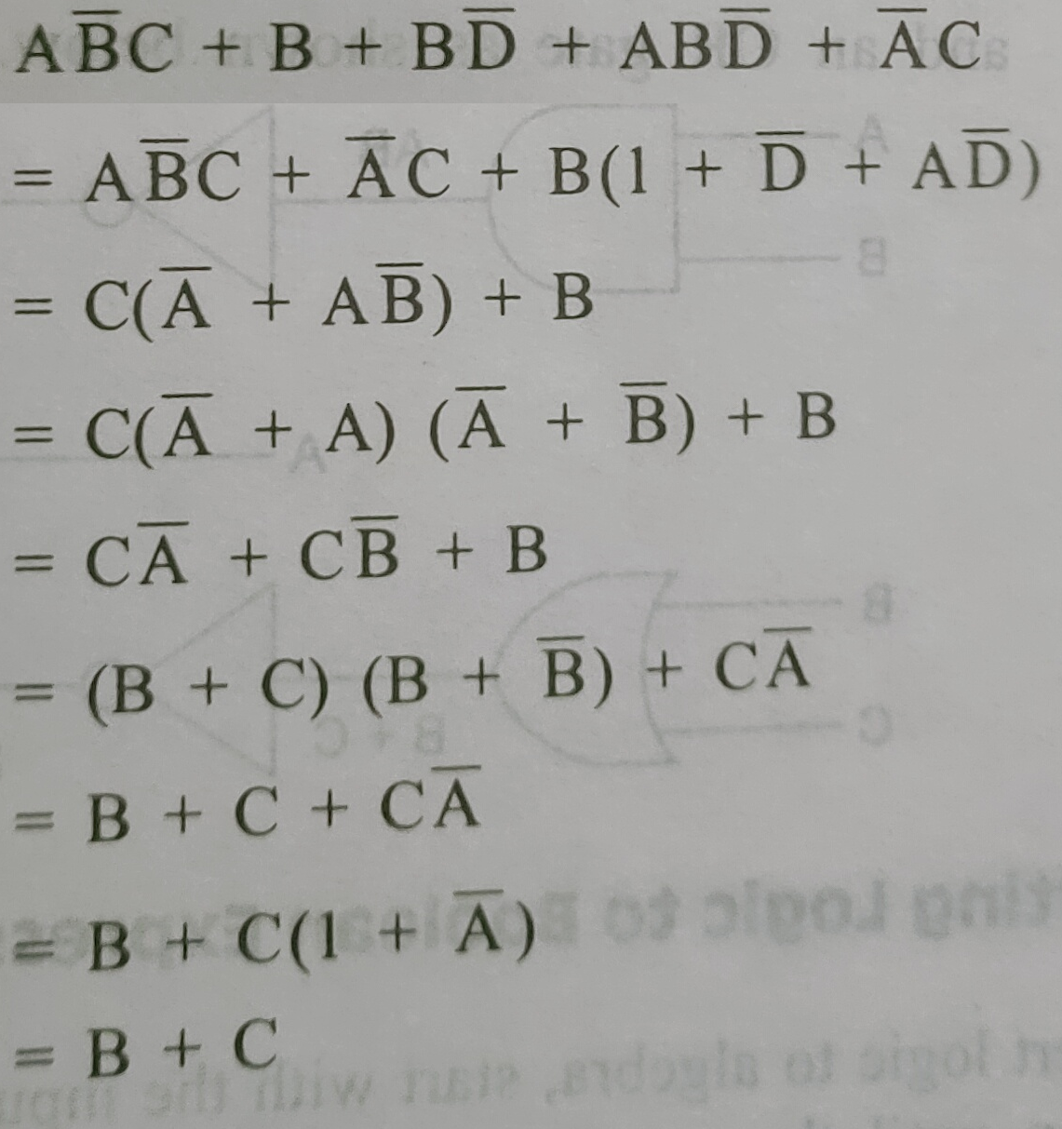
Example: Show that
Solution

Slide 14
Example: Find the complement of the function F₁ = x’yz’ + x’y’z.
Solution
F₁ = x’yz’ + x’y’z
F₁’ = (x’yz’ + x’y’z)’
= (x’yz’)’ (x’y’z)’
= (x + y’ + z)(x + y + z’)

Slide 15
Example: Find the complement of the function F₂ = x(y’z’ + yz).
Solution
F₂ = x(y’z’ + yz)
F₂’ = [x(y’z’ + yz)]’
= x’ + (y’z’ + yz)’
= x’ + (y’z’)’(yz)’
= x’ + (y + z)(y’ + z’)

Slide 16
Example: Find the complement of the function F₁ = x’yz’ + x’y’z by taking their duals and complementing each literal.
Solution
F₁ = x’yz’ + x’y’z
The dual of F₁ is (x’ + y + z’)(x’ + y’ + z)
Complement each literal:
(x + y’ + z)(x + y + z’) = F₁’

Slide 17
Example: Find the complement of the function F₂ = x(y’z’ + yz) by taking their duals and complementing each literal.
Solution
F₂ = x(y’z’ + yz)
The dual of F₂ is x + (y’ + z’)(y + z)
Complement each literal:
x’ + (y + z)(y’ + z’) = F₂’

Slide 18
Example: Find the complement of F = x + yz; then show that FF’ = 0 and F + F’ = 1.
Solution
F = x + yz
F’ = (x + yz)’ = x’ (yz)’ = x’(y’ + z’) = x’y’ + x’z’
FF’ = (x + yz) (x’y’ + x’z’)
= xx’y’ + xx’z’ + yzx’y’ + yzx’z’ = 0
F + F’ = (x + yz) + (x + yz)’ = 1

Slide 19
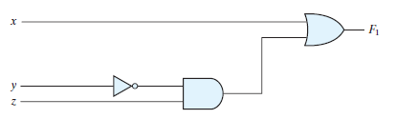
Example: Draw logic diagrams to implement the following Boolean expression: F₁ = x + y’z

Slide 20
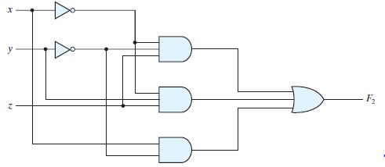
Example: Draw logic diagrams to implement the following Boolean expression: F₂ = x’y’z + x’yz + xy’

Slide 21
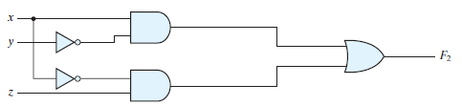
F₂ = x’y’z + x’yz + xy’
= x’z(y’ + y) + xy’ = x’z + xy’

Slide 22
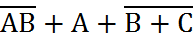
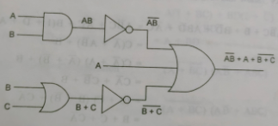
Example: Draw logic diagrams to implement the following Boolean expression:

